Slide 1




AI reinvention made real
Accenture Innovation Challenge 2026
Copyright © 2025 Accenture. All rights reserved.
‹#›
Notes:
1

Slide 2

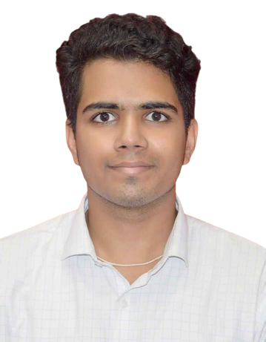

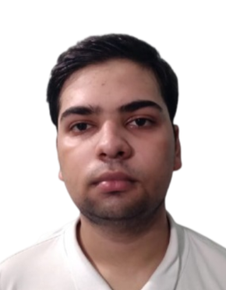



ControlPlane.ai
Team details
TEAM NAME: 23je0841
Sahil Bhavesh Choudhary
Mayank Raj
College: IIT (ISM) Dhanbad
Stream: B.Tech - Petroleum Engineering
Year of graduation: 2027
College: IIT (ISM) Dhanbad
Stream: B.Tech - Petroleum Engineering
Year of graduation: 2027
Saket Kumar Singh
College: IIT (ISM) Dhanbad
Stream: B.Tech - Petroleum Engineering
Year of graduation: 2027
3

Slide 3








ControlPlane.ai
ControlPlane.ai:
Sidecar Orchestration
The Problem: After the Fact Discovery
Current AI deployments lack real-time telemetry across inference planes. Waiting for user feedback to identify confidently wrong, expensive, or unsafe outputs is a critical operational failure.
The Technical Approach
Using a non blocking sidecar proxy to intercept LLM payloads at the network layer. Leveraging an asynchronous, event-driven architecture (Kafka/Redis), it forks the stream; delivering the primary response to the user instantly while micro agents perform parallel, real time verification to eliminate system bottlenecks.
The difference between finding out and finding it first.

Slide 4
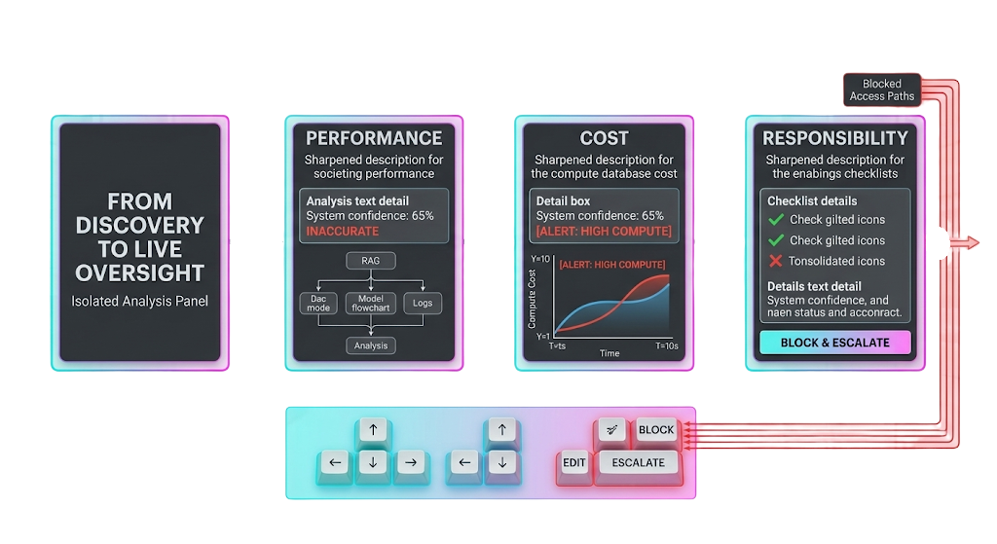



ControlPlane.ai
Solution
Foundations
Perfromance
Cost
Responsibility
Asynchronous Evaluation Micro Agents
ControlPlane Checker decouples evaluation from generation. By utilizing an asynchronous, multi agent orchestration layer, we ensure continuous, real-time oversight across all dimensions without introducing system latency.
Performance Agent:
Cost Telemetry:
Responsibility Layer:
Combats hallucinations using RAG verification and quantized Cross Encoders to score real-time semantic similarity against grounded enterprise context.
Monitors active generation loops using streaming token heuristics to prevent compute burn, applying Redis caching and dynamic rate-limiting.
Deploys ultra-fast NER pipelines and toxicity classifiers to scan outbound payloads, preventing data leakage and enforcing enterprise guardrails.

Slide 5



ControlPlane.ai
Dynamic Action Engine & Mitigation
How the ControlPlane resolves latency and acts on flagged telemetry without crippling the primary LLM pipeline:
01
02
03
Pass-Through (Low Risk)
Auto-Edit (Medium Risk)
Block & Escalate (High Risk)
Stream proceeds uninterrupted. Asynchronous background evaluation yields <50ms TTFT (Time To First Token) overhead.
If PII is detected mid-stream, a lightweight Regex/NER mask applies inline replacement () before flushing the buffer to the client.
For severe toxicity or massive context hallucination, the proxy forcibly tears down the TCP/WebSocket connection and fires a webhook to the HITL dashboard.

Slide 6

Thank you
Copyright © 2026 Accenture. All rights reserved.
‹#›

